Slide 1
Teaching a Computer to Compose
How a small neural network learns to write music, explained step by step
Enock Katui · [Event / date]
Notes:
Welcome. No maths or coding experience needed. By the end, everyone will have heard a melody that a computer wrote after learning from examples.

Slide 2
Why teach a computer to make music?
Kenya's sound is rich
Creators can use help
Easy to check
Benga, gospel, Genge, Gengetone, taarab. Each has patterns that repeat, and computers are good at spotting patterns.
Small studios and artists can use AI for fresh ideas, jingles and backing tracks.
You can simply listen to hear whether the computer learned well.
Build & train a small neural network · 2/10
Notes:
Ask who has made or recorded music. Explain: a neural network is a program that learns from examples instead of following hand-written rules.

Slide 3

Music is a list of notes in order
C4 · E4 · G4 · E4
Model
next note: C5?
Like your phone suggesting the next word as you type, our model guesses the next note. Repeat that guess again and again and you get a whole tune.
A neural network is a program made of many tiny number-crunching units, loosely inspired by brain cells. It learns by studying lots of examples.
Build & train a small neural network · 3/10
Notes:
C4 means the note C in the 4th octave (middle C). Keep the phone-keyboard analogy going all session.

Slide 4
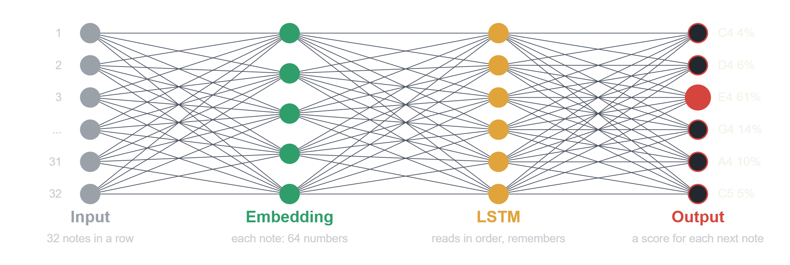
The whole network
Circles are small units that pass numbers along. Lines are connections. Learning means adjusting how strong each line is. Only a few circles per layer are drawn.
Build & train a small neural network · 4/10
Notes:
Walk left to right: 32 notes in, each turned into a 64-number vector, the LSTM reads them in order and builds a memory of the melody, the output layer scores every possible next note. Highlighted node: the model is 61% sure the next note is E4 (illustrative numbers). Only a few nodes per layer are drawn.

Slide 5
Turning music into numbers
Step | What happens
1. Read the music file | A MIDI file is a list of notes, like sheet music for computers
2. Give each note an ID | Computers only understand numbers, so every different note gets its own number
3. Make practice questions | Show 32 notes in a row and ask: what note comes next?
4. Hide some music | 90% to learn from, 10% kept back to test the model
Our built-in practice tunes use 9 notes from a pentatonic scale (five notes per octave, found in music from many cultures). You can use your own MIDI files instead.
Build & train a small neural network · 5/10
Notes:
Each note ID is called a token. The 'window' is the 32 notes we show the model at once.

Slide 6
The model: three layers
1. Embedding
2. LSTM
3. Output layer
Turns each note into a list of 64 numbers that describe it, so similar notes get similar numbers.
A layer built to remember. It reads the notes in order and keeps a memory of the tune so far.
Gives every possible next note a probability, like 61% for E4.
In total there are about 100,000 adjustable numbers (called parameters). That is tiny: big AI models have billions.
Build & train a small neural network · 6/10
Notes:
LSTM stands for Long Short-Term Memory. The output layer uses softmax, which just turns scores into percentages that add up to 100%.

Slide 7
Training: learning from mistakes
Loss = the mistake score
Optimizer = the coach
Validation = the surprise test
A number showing how wrong a guess was. Lower is better.
After each round of guesses it nudges the model's numbers so the next guesses are a little better.
We test on music the model never practised on. If the practice score improves but the test score gets worse, it is memorising, not learning. This is called overfitting.
Build & train a small neural network · 7/10
Notes:
Loss here is cross-entropy; the optimizer is Adam. Beginners only need the coach and mistake-score ideas. Use the loss graph in the notebook to show overfitting.

Slide 8
The maths in four formulas
1. One unit
2. Scores to percentages
y = f(w₁x₁ + w₂x₂ + … + b)
pᵢ = exp(zᵢ / T) / Σⱼ exp(zⱼ / T)
Multiply each input x by a weight w, add them up with a bias b, then squash with a function f. The weights are what the network learns.
Softmax turns the output scores z into percentages. A small temperature T makes picks safer, a large T makes them wilder.
3. The mistake score (loss)
4. The learning step
L = −log(p)
w ← w − η · ∂L/∂w
p is the probability given to the true next note. 61% gives L ≈ 0.49, but 5% gives L ≈ 3.0. A bigger mistake means a bigger loss.
∂L/∂w says how the loss changes if weight w changes. Move w a small step η (the learning rate) downhill. Adam is a smarter version.
Build & train a small neural network · 8/10
Notes:
Walk through each formula with the plain-words line first. For advanced listeners, the LSTM memory update is: forget gate f = σ(W_f[h_prev, x] + b_f); input gate i = σ(W_i[h_prev, x] + b_i); candidate c~ = tanh(W_c[h_prev, x] + b_c); memory c = f·c_prev + i·c~; output gate o = σ(W_o[h_prev, x] + b_o); output h = o·tanh(c). Parameter count: 4 × (128 × (64 + 128) + 128) = 98,816 in the LSTM. Loss values use the natural logarithm. Gradient descent shown is the basic version; Adam adapts the step size per weight.

Slide 9
Making new music
Temperature is a dial for how adventurous the model is.
Temperature | What you hear
0.5 | Safe and repetitive
1.0 | A good balance
1.5 | Adventurous, but often sounds wrong
How it works: start with a few notes, guess the next one, add it to the tune, and repeat.
Build & train a small neural network · 9/10
Notes:
Let the audience vote on a temperature, then generate and play it.

Slide 10
Your turn, then take it further
Hands-on (15 min)
Take it further
Open the notebook and press Run. Make a tune. Change the temperature. Try your own MIDI files.
Add rhythm and chords, or try newer models called Transformers. Only train on music you own or have permission to use, and credit the artists.
Build & train a small neural network · 10/10
Notes:
Close by asking people to share their favourite generated tune. Stress credit and consent for training data.

